Slide 1

DEPARTMENT OF ARTIFICAL INTELLIGENCE AND DATA SCIENCE
Project Phase-2
Review 2
“A Hybrid Neural Network for EEG-based Depression Screening Using CNN-LSTM”
Project Team Members
Name USN
B.LATHA SREE 1SJ22AD006
C S MOUNIKA 1SJ22AD008
M.CHARAN 1SJ22AD024
Project Guide
Badrinath K
Assistant Professor

Slide 2

A Hybrid Neural Network for EEG-based Depression Screening Using CNN
TABLE OF CONTENTS
  Abstract
  Introduction
  Problem Statement
  Objectives
  Design
  Modules Split-up
  Implementation
  Testing
  Screen shots of output
  Conclusion and Future enhancement
  References

Slide 3
A Hybrid Neural Network for EEG-based Depression Screening Using CNN
ABSTRACT
Depression is a widespread psychological disorder affecting people of all ages. Early diagnosis is crucial, and EEG signals can help assess mental health. This project proposes a fully automated Depression Detection System using a novel Hybrid Neural Network, DepHNN, which combines CNN for temporal learning and LSTM for sequence learning. EEG data from 34 depressed and 30 normal drug-free individuals were used. The system achieves 98.27 accuracy and a MAE of 0.0237, offering an efficient, accurate, and low-complexity solution for EEG-based depression screening.

Slide 4
A Hybrid Neural Network for EEG-based Depression Screening Using CNN
INTRODUCTION
Depression affects over 322 million people worldwide, with a higher incidence among females. Although it is a treatable condition, nearly half of the cases remain undiagnosed due to factors like limited awareness, insufficient resources, and incorrect diagnoses. EEG signals, being non-invasive and cost-effective, serve as valuable biomarkers for identifying neurological disorders, including depression. However, their complexity makes manual analysis challenging. To address this, the project proposes a hybrid LSTM-CNN model (DepHNN) for efficient and accurate detection of depression using EEG data.

Slide 5
A Hybrid Neural Network for EEG-based Depression Screening Using CNN
PROBLEM STATEMENT
Depression is a major mental health issue affecting over 322 million people worldwide, contributing to significant emotional, social, and economic burdens. Traditional methods for diagnosing depression, such as clinical interviews and self-reported questionnaires, are subjective and time-consuming. EEG-based diagnosis provides objective insights into brain activity but is prone to human error due to the complexity of interpreting EEG signals. Thus, there is a critical need for an automated and accurate depression screening system using EEG signals.

Slide 6
A Hybrid Neural Network for EEG-based Depression Screening Using CNN
OBJECTIVES
Develop a CNN-LSTM model for automated depression detection using EEG signals.
Improve adaptability using cross-validation and diverse datasets.
Apply regularization techniques such as L2 regularization and adaptive learning rate optimization.
Enhance model accuracy and generalization using dropout, data augmentation, and early stopping.
Minimize computational complexity and latency to enable real-time depression screening on portable and cloud-based platforms.

Slide 7
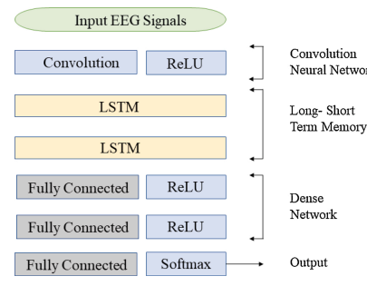
A Hybrid Neural Network for EEG-based Depression Screening Using CNN
  DESIGN AND ARCHITECTURE
Model Architecture

Slide 8

.
A Hybrid Neural Network for EEG-based Depression Screening Using CNN
MODULES SPLIT-UP
LIST OF MODULES
CNN (Convolutional Neural Network)
LSTM (Long Short-Term Memory)
ReLU (Rectified Linear Unit)
Softmax

Slide 9
A Hybrid Neural Network for EEG-based Depression Screening Using CNN
Module 1: CNN(Convolutional Neural Network)
CNN is a is a deep learning model mainly used for feature extraction from data such as images or EEG signals.
It captures spatial and temporal patterns automatically using convolution and pooling operations.
Purpose in the Model:
Extracts key spatial features from EEG data.
Captures local signal patterns automatically.
Reduces manual feature extraction.
Provides feature maps for LSTM processing.

Slide 10
.
A Hybrid Neural Network for EEG-based Depression Screening Using CNN
Module 2:LSTM (Long Short-Term Memory)
LSTM is a type of Recurrent Neural Network (RNN) designed to model time-series or sequential data by remembering long-term patterns.
It uses internal memory (called cells) and gates to regulate the flow of information.
Purpose in the Model:
Remembers important patterns over multiple time steps.
Helps understand temporal dependencies in EEG signals.
Improves performance on sequence data like brainwave activity.
Avoids vanishing gradient problems found in traditional RNNs.

Slide 11
A Hybrid Neural Network for EEG-based Depression Screening Using CNN
Module 3: Softmax
Softmax is an activation function used in the output layer of a neural network for classification tasks.
It converts raw scores (logits) into probabilities, so that the sum of all output values equals 1
Purpose in the Model:
Converts the model’s raw output into interpretable probabilities.
Helps the model make a clear decision about which class (e.g., depressed / not depressed) the input belongs to.
Ensures the output is a probability distribution.
Module 4:ReLU (Rectified Linear Unit)
ReLU is an activation function used in neural networks.
Purpose in the Model:
Adds non-linearity to the model.
Allows the neural network to learn complex features.
Speeds up convergence compared to sigmoid/tanh

Slide 12
A Hybrid Neural Network for EEG-based Depression Screening Using CNN
IMPLEMENTATION
1. CNN Algorithm
Input Layer: Receives EEG windows of shape (19 × 256).
Conv1D Layer:
  Filters: 64 filters with a kernel size of 5.
  Sliding Window: Each filter slides along the time dimension, simultaneously examining all 19 channels.
  Spatial Feature Learning: Filters capture diverse spatial patterns, including low/high-frequency waves, eye-blink artifacts, and frontal alpha asymmetry.
Activation (ReLU): Rectified Linear Unit sets negative values to zero, preserving key activations and reducing noise.
Output Feature Map: Produces a high-level spatial representation, e.g., (64 filters × 252 time steps), which is then passed to LSTM layers for temporal modeling.

Slide 13
A Hybrid Neural Network for EEG-based Depression Screening Using CNN
CNN Implementation Snippet:
from tensorflow.keras.models import Sequential
from tensorflow.keras.layers import Conv1D, ReLU
model = Sequential()
# Input: (256 time steps, 19 channels)
model.add(Conv1D(filters=64, kernel_size=5, input_shape=(256, 19)))
model.add(ReLU())
# Output: feature map of shape (252, 64)

Slide 14
A Hybrid Neural Network for EEG-based Depression Screening Using CNN
2. LSTM Alogrithm
Input Layer: Receives CNN feature map as a sequence over time.
Stacked LSTM Layers:
  First Layer: 64 units capturing short- and mid-term temporal dependencies.
  Second Layer: 32 units for higher-level temporal abstraction.
Gating Mechanisms: Input, forget, and output gates control memory updates and flow of information.
Output: Final hidden state encodes temporal EEG patterns, passed to dense layers for classification.

Slide 15
A Hybrid Neural Network for EEG-based Depression Screening Using CNN
LSTM Implementation Snippet:
from tensorflow.keras.models import Sequential
from tensorflow.keras.layers import LSTM, Dense
model = Sequential()
model.add(LSTM(64, return_sequences=True, input_shape=(252,64)))
model.add(LSTM(32))
model.add(Dense(16, activation='relu'))
model.add(Dense(2, activation='softmax')) # Depressed / Healthy

Slide 16
A Hybrid Neural Network for EEG-based Depression Screening Using CNN
TESTING
1. UNIT TESTING:
Test Case | Test Name | Test Description | Input | Expected Output | Actual Output | Test Result
UTC01 | User Model Functionality | To verify creation, validation, and password hashing of the CustomUser model. | Valid and invalid user data (missing username, weak password, etc.) | User is created successfully with valid data, errors are raised for missing fields, and password is hashed correctly. | Model loads successfully and returns valid prediction output. | Success
UTC02 | OTP Generation | To test OTP generation, database storage, and expiry mechanism. | OTP request for a registered user | A 6-digit OTP is generated, stored, and correct | OTP generated correctly, stored in model | Success

Slide 17
A Hybrid Neural Network for EEG-based Depression Screening Using CNN
UTC03 | Form Validation (Registration & Login) | To validate input data for RegistrationForm and LoginForm. | Valid/invalid email, password, and username combinations | Forms accept valid inputs, reject invalid/duplicate entries. | Validation and error handling performed as expected. | Success
UTC04 | EEG Data Preprocessing | To verify preprocessing steps using MNE-Python functions. | EEG .edf files (valid and invalid) | Data loaded, filtered (0.5–45 Hz), resampled to 256 Hz, ICA applied, normalized, and windowed correctly. | Each preprocessing function executed correctly, invalid files handled gracefully. | Success
UTC05 | Keras Model Loading and Prediction | To ensure model loads and performs prediction with correct input shape. | Dummy EEG input of shape (1, 19, 256) | Model loads successfully and returns valid prediction output. | Model loaded without error and predicted correctly. | Success

Slide 18
A Hybrid Neural Network for EEG-based Depression Screening Using CNN
2. INTEGRATED TESTING:
Test Case | ITC01
Test Name | Module Interaction and Data Flow Validation
Test Description | To verify that integrated modules function correctly and data flows seamlessly between system components.
Input | User registration, login, EEG file upload, and prediction requests.
Expected Output | Successful user creation and authentication, proper preprocessing of EEG data, and accurate model prediction with a JSON response.
Actual Output | All modules interacted correctly-registration, login, preprocessing, and prediction executed smoothly with consistent data flow.
Test Result | Success

Slide 19
A Hybrid Neural Network for EEG-based Depression Screening Using CNN
3. SYSTEM TESTING:
Test Case | STC01
Test Name | End-to-End System Functionality Validation
Test Description | To verify that the fully integrated DepHNN Analyzer performs all operations correctly under real-world conditions, including data upload, analysis, and prediction.
Input | EEG .edf files (both healthy and depressed datasets) uploaded by registered users.
Expected Output | The system should successfully complete the full workflow — registration, login, file upload, analysis, result display, and logout — with accurate depression predictions and stable performance.
Actual Output | The complete workflow was executed successfully with consistent and accurate predictions; system remained stable under load.
Test Result | Success

Slide 20
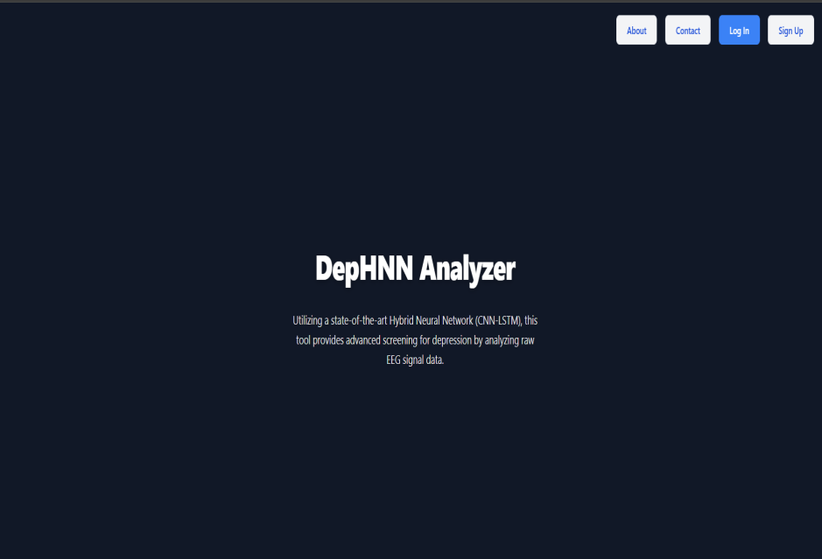
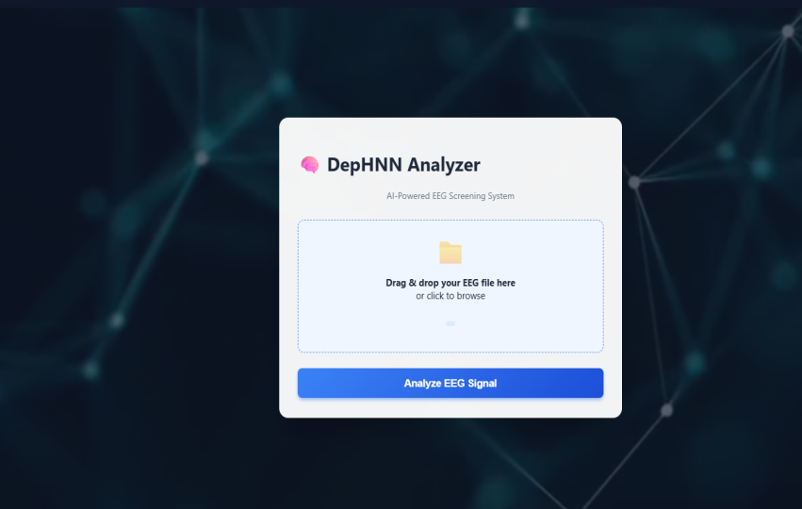
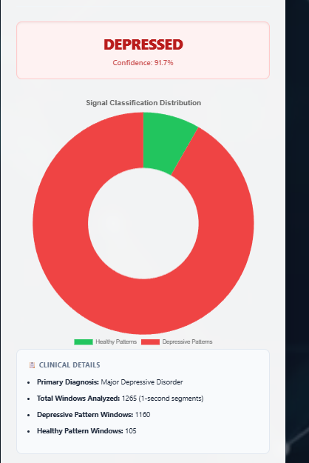
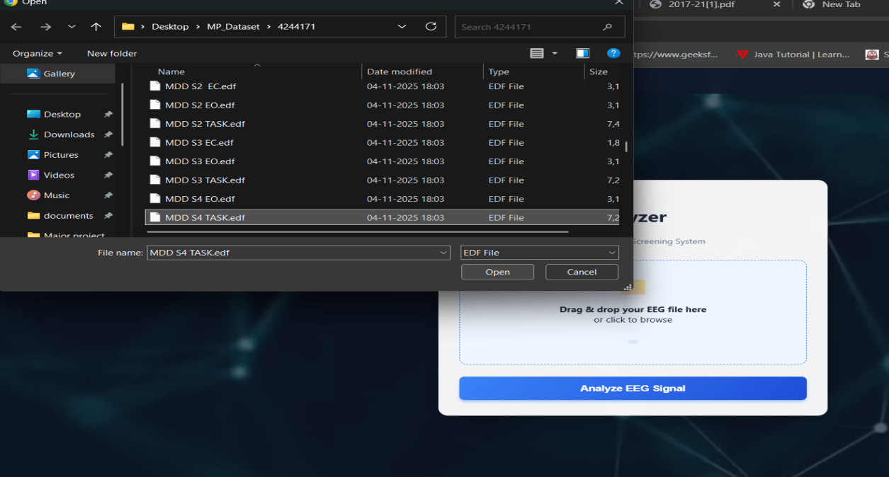
A Hybrid Neural Network for EEG-based Depression Screening Using CNN
SCREEN SHOTS OF OUTPUT

Slide 21
A Hybrid Neural Network for EEG-based Depression Screening Using CNN
CONCLUSION
DepHNN is a hybrid deep learning model combining CNN and LSTM for automated depression detection using EEG signals. It efficiently extracts temporal and sequential features without manual engineering and achieves high accuracy with minimal error and computation time. The model surpasses existing approaches in accuracy, efficiency, and robustness, making it a reliable computer-aided tool for early depression screening. Future improvements can enable severity analysis, use of larger datasets, and integration with IoMT systems for real-time mental health monitoring.

Slide 22
A Hybrid Neural Network for EEG-based Depression Screening Using CNN
FUTURE ENHANCEMENT
The system can be extended beyond binary classification to estimate depression severity levels, providing deeper clinical insights. Incorporating longitudinal EEG monitoring enables continuous tracking of treatment response and early relapse detection. By integrating multi-modal data such as EEG signals, heart rate variability, speech patterns, and facial micro-expressions, the system can offer a more comprehensive and reliable diagnosis of depressive disorders.

Slide 23
A Hybrid Neural Network for EEG-based Depression Screening Using CNN
REFERENCES
[1] Automated EEG-based screening of depression using deep convolutional neural network, U. R. Acharya, H. Fujita, S. L. Oh, Y. Hagiwara, J. H. Tan, and M. Adam
https://doi.org/10.1016/j.compbiomed.2018.06.008
[2] Deep convolutional neural network model for automated diagnosis of depression using EEG signals, S. L. Oh, U. R. Acharya, Y. Hagiwara, J. H. Tan, and H. Adeli
https://doi.org/10.3390/app9153319
[3] Implementation guides for CNN and LSTM using Keras’ Sequential API.
https://keras.io/guides/sequential_model/
[4] U.R. Acharya, S.L. Oh, Y. Hagiwara, J.H. Tan, H. Adeli, D.P. Subha, Automated EEG-based screening of depression using deep convolutional neural network, Comput. Methods Programs Biomed. 161 (2018) 103–113. https://www.sciencedirect.com/science/article/pii/S0169260718301494
[5] Electroencephalogram (EEG)-based computer-aided technique to diagnose major depressive disorder (MDD)” by W. Mumtaz, L. Xia, S. S. A. Ali, M. A. M. Yasin, M. Hussain, A. S. Malik (2017), https://www.sciencedirect.com/science/article/abs/pii/S1746809416300866
[6] Deep convolutional neural networks for computer-aided detection: CNN architectures, dataset characteristics and transfer learning” by H.-C. Shin, H. R. Roth, M. Gao, L. Lu, Z. Xu, I. Nogues, J. Yao, D. Mollura, R. M. Summers (2016), https://pubmed.ncbi.nlm.nih.gov/26886976/

Slide 24


